Slide 1
EXPLOSIVE CONSOLIDATION OF B₄C-Al AND SiC-Al COMPOSITES
Onuralp Yucel
Istanbul Technical University,
Department of Metallurgical & Materials Engineering, Maslak, Istanbul, 34469, Turkey
XII International Symposium on Explosive Production of New Materials: Science, Technology, Business, and Innovations (EPNM-2014)

Slide 2
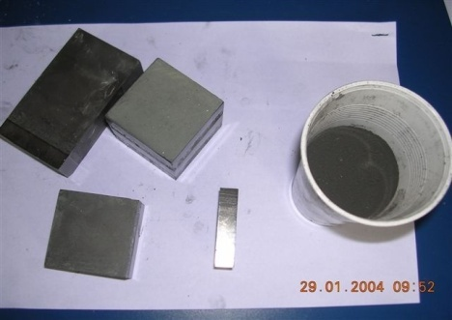
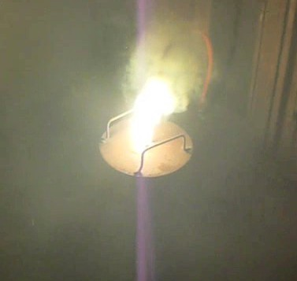
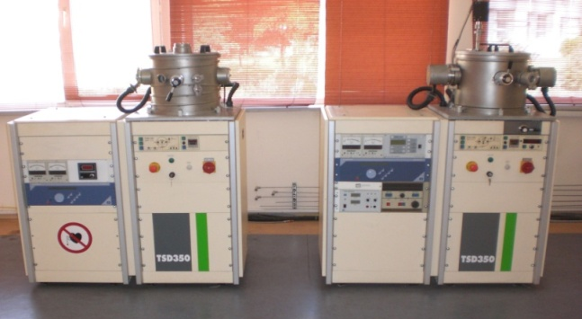
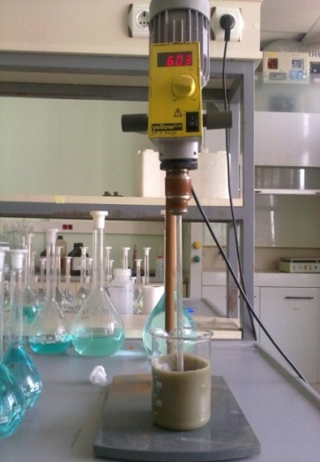
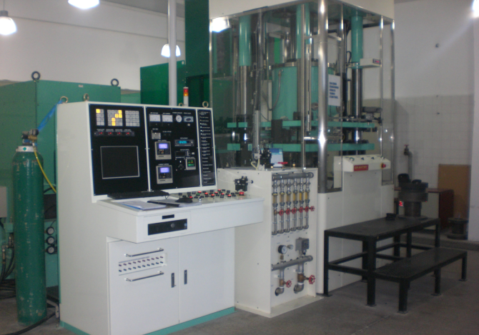
Summary of the Study
This study covers information about our previous and ongoing researches on the production of advanced alloys, ceramic powders and their composites via,
Carbothermic Synthesis and Self-propagating High-temperature Synthesis (SHS) processes,
Powder sintering processes with HP and SPS systems,
Explosive Consolidation process.

Slide 3
AREA OF INTEREST
Extractive Metallurgy:
Smelting and reduction of slags, production of ferroalloys, alloys and metals by carbothermic and metalothermic processes in EAF or in ladle.
(copper, cobalt, vanadium, chromium, ferroboron, cobaltboron, nicelboron, ferromanganese, silicomanganese, ferrovanadium, ferrotungsten, ferrochromium and aluminum-titanium-boron alloys).
Pyro and hydrometallurgy of base and precious metals from their ores. Optimization and development of new techniques and techniques in use (Gold, silver, copper, nickel, cobalt strontium, magnesium, molybdenum, tin).
Ceramic Powder Production and Processing:
Production of carbide, nitride, boride powders and their processing by explosive consolidation or sintering techniques.
Thin Film Coatings:
Production and characterization of thin films obtained by using RF-PECVD.
Beneficiation of Industrial Wastes:
Production of metals and compounds from galvanizing ash, brass production wastes and vanadium sludges produced aluminum production. Grit production from aluminum, copper and steel slags.

Slide 4
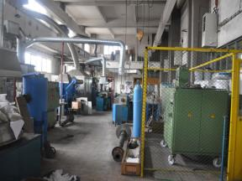
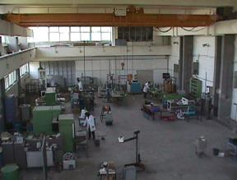
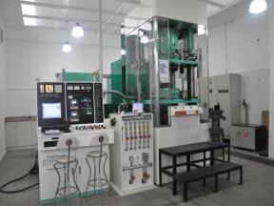
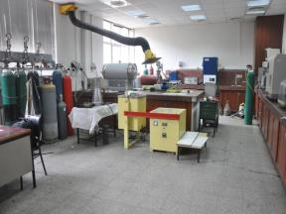
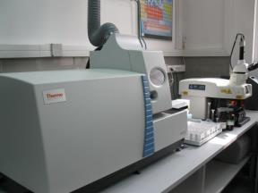
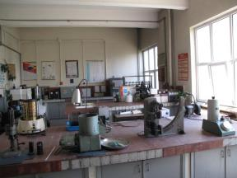
OUR LABORATORIES
Extractive Metallurgy Lab.
Casting Lab.
SPS Lab.
Pyrometallurgy Lab.
Hydrometallurgy Lab.
Solidification Lab.
Also:
- Chemical Analysis Lab. - Hot Press Sintering Lab. - Enamel Lab.

Slide 5
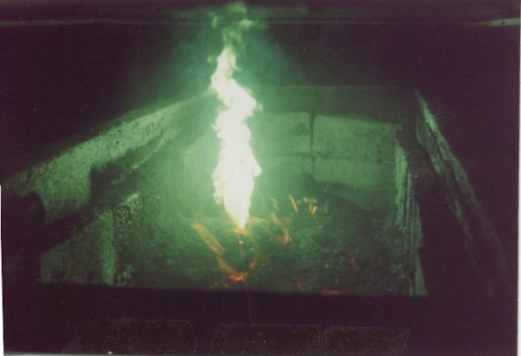
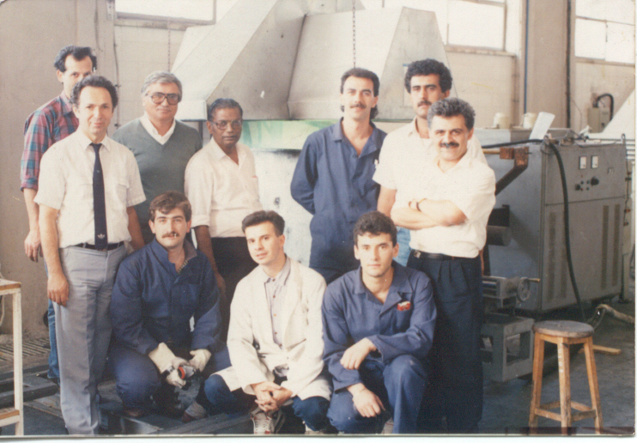
B₄C powder production from boric acid using Acheson Process
1989

Slide 6
Self Propagating High Temperature Synthesis (SHS),
Metallothermic Reduction Applications
Slag
Green
mixture
Slag
Smelting and
Phase Seperation
Solidification
and cooling
Solidification
and cooling
Smelting and
Phase Seperation
Combustion
Combustion
FeCr Alloy
FeCr Alloy
Liquid Slag
Liquid Metal
Liquid Slag
Liquid Metal
Metals, alloys, ferroalloys,
Advanced ceramics,
Intermetallics,
Welding and metal joining,
Oxygen free single crystals, etc.
In these processes, after initiation, reaction becomes self-sustaining and propagates in the reactant mixture.
A high amount of heat which is generated during the process accelerates the reaction rate and thus it makes the process highly productive and economically feasible for different production scales.

Slide 7
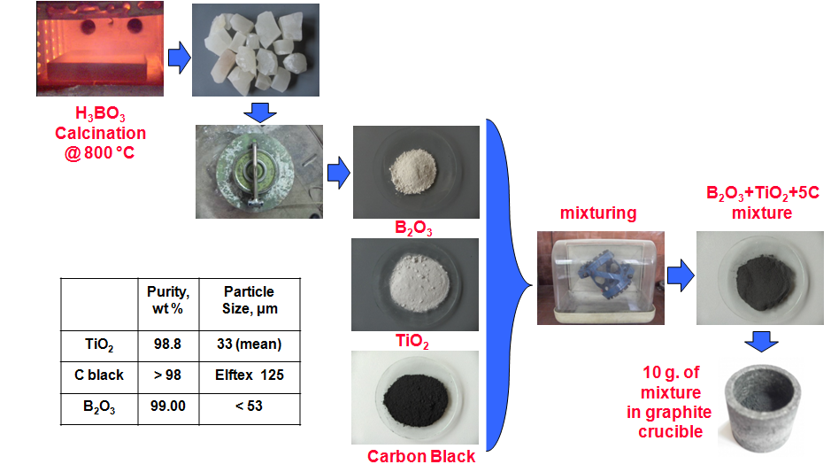
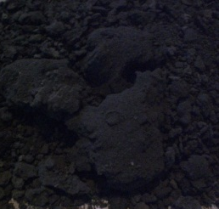
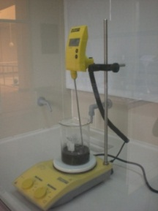
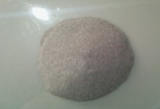
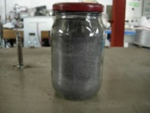
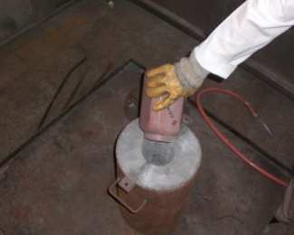
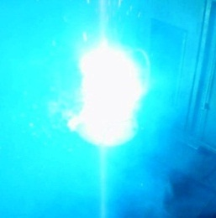
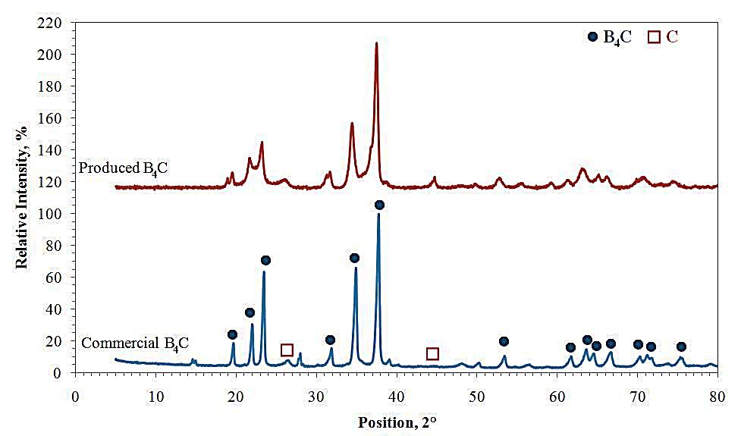
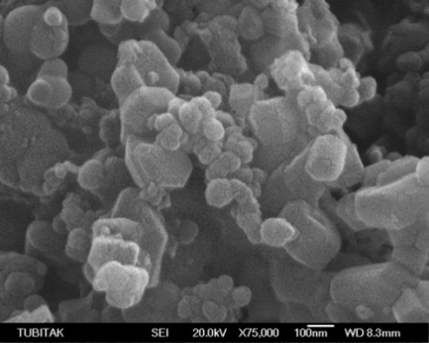
Experimental Procedure
B₂O₃ + 0.5 C + 3 Mg → 0.5 B₄C + 3 MgO
ZrO₂ + B₂O₃ + 5 Mg → ZrB₂ + 5 MgO
TiO₂ + B₂O₃ + 5 Mg → TiB₂ + 5 MgO
a WO₃ + b B₂O₃ + c Mg → W_{x}B_{y} + z MgO
B₂O₃+ 3 Mg + ½ C
Raw Materials | Purity, wt % | Particle Size, µm
Mg | 99.7 | < 150
H₃BO₃ | 99.5 | -
B₂O₃ | 97.0 | < 53
C | 98.0 | -
ZrO₂ | 99.0 | < 106
TiO₂ | 98.8 | < 75
CaWO₄ | 98.0 | < 106
WO₃ | 99.8 | < 106
Mg

Slide 8
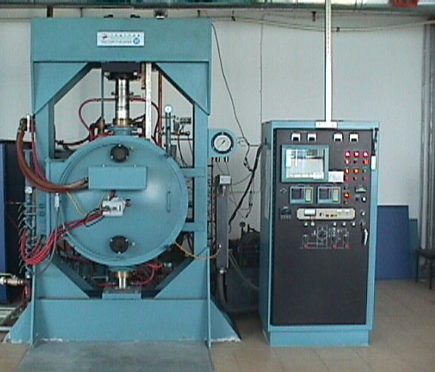
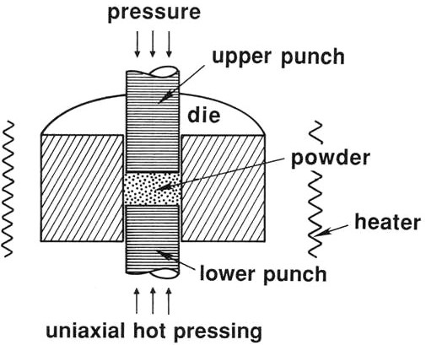
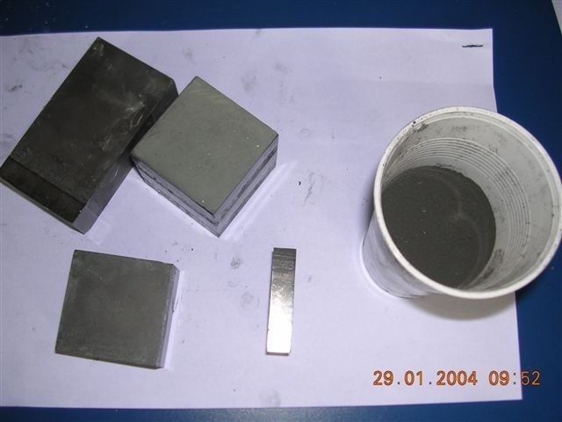
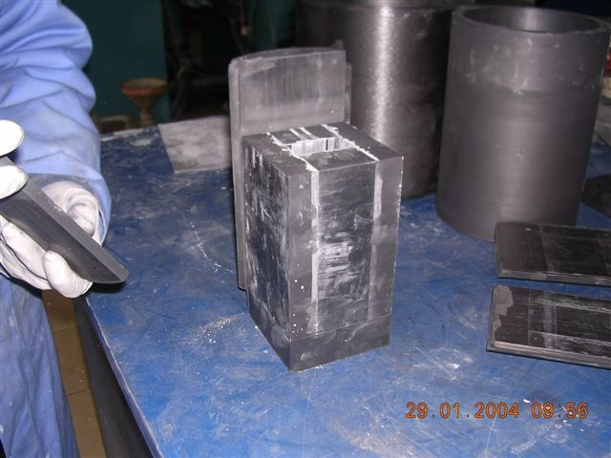
Sintering of WC, B₄C, SiC, TiB₂ and their composites using Hot Pressing

Slide 9
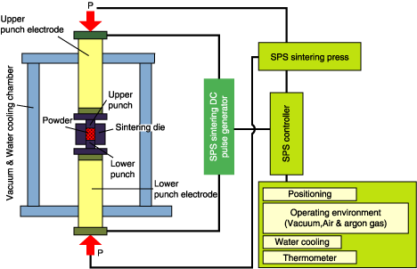
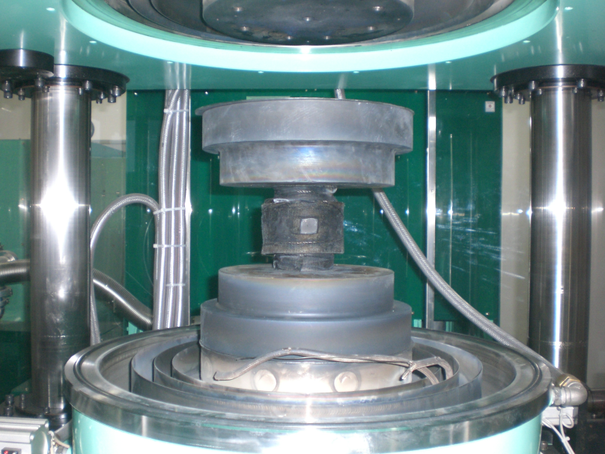
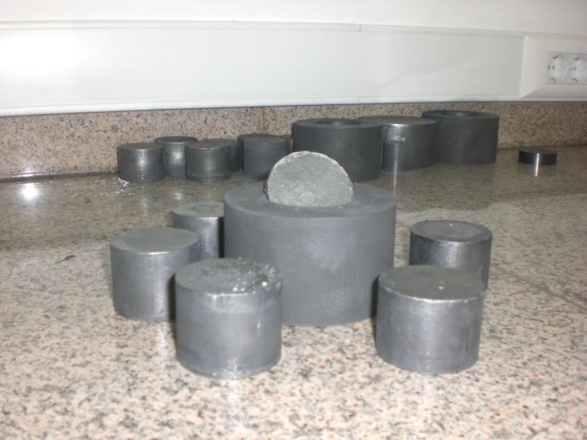
Spark Plasma Sintering System

Slide 10
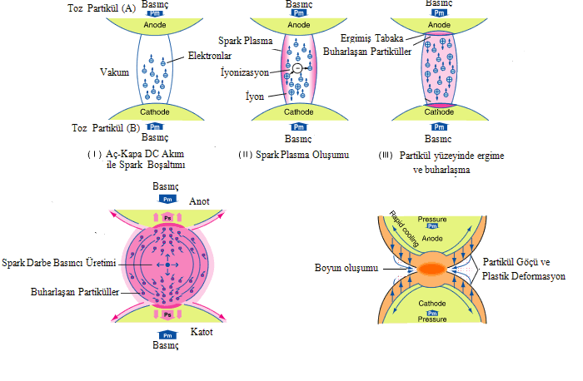
Neck Formation in Spark Plasma Sintering

Slide 11
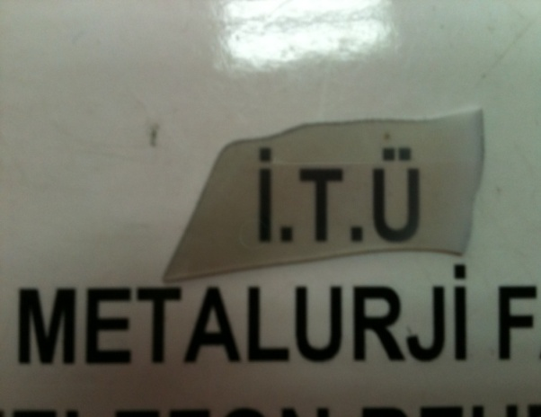
Some Examples from Advanced Ceramic Materials Produced by SPS System
Non-oxide Ceramics and Composites; B₄C, WC, TiB₂, ZrB₂, B₄C-SiC, B₄C-TiB₂ WC-B₄C, Al - B₄C
Oxide Ceramics;
Al₂O₃ ceramics, AlON ceramics, HAP, Transparent Al₂O₃ based ceramics, KNN Piezoceramics
Metals and Alloys;
Ti6Al4V, Oxide Dispersed Steel, Austenitic Y₂O₃ Strengthened Steel
Produced transparent Al₂O₃
SEM image of WC-Co sintered sample

Slide 12
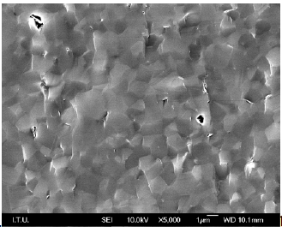
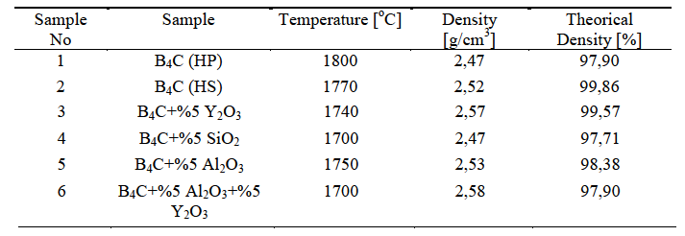
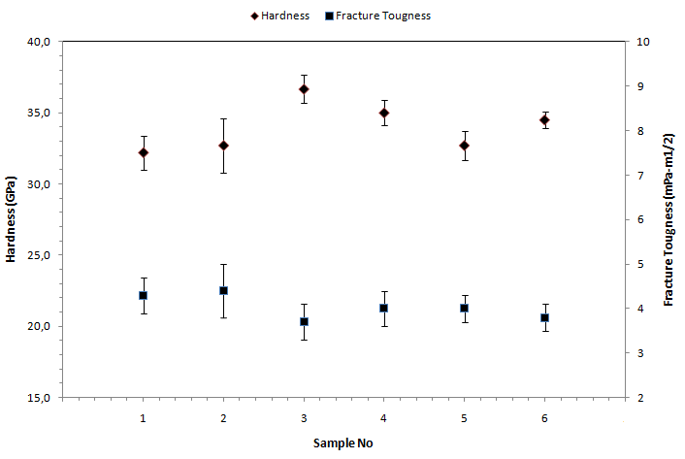
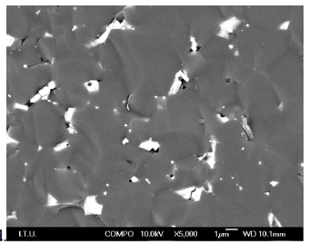
B₄C ceramics
Densities of boron carbide samples sintered by SPS
SEM image of fractured surface of pure HS grade B₄C sample
SEM images of fractured surface of pure HS grade B₄C + Al₂O₃ sample
Hardness and fracture toughness values of samples

Slide 13
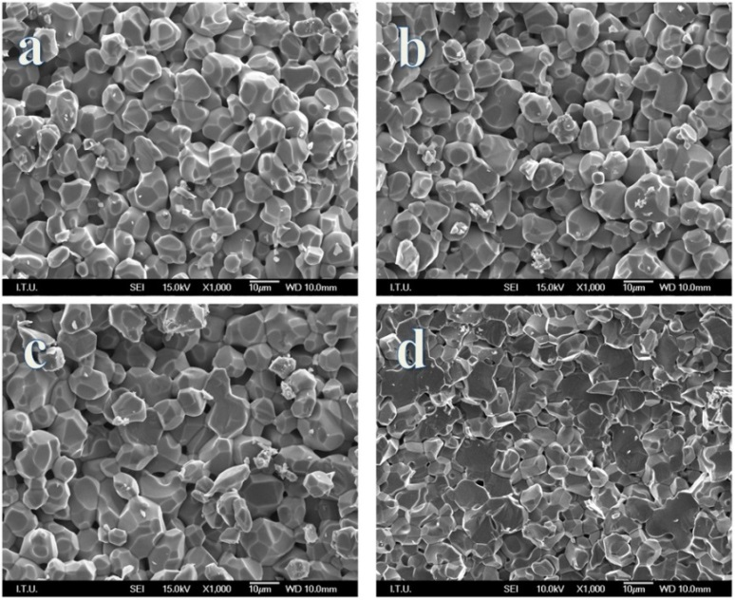
TiB₂ ceramics
Sintering parameters of monolithic TiB₂ ceramics were investigated by using SPS. Effects of sintering temperature between 1600 °C and 1800 °C, sintering pressure of 50 MPa and 70 MPa, sintering pressure mode as initial and after 1500 °C, sintering atmosphere of vacuum and argon and the application of mechanical activation prior to sintering were among the parameters to investigate.
Sample | Sintering Temp., °C | Relative Density, % | Hardness, GPa
MA+SPS | 1800 | 99.23 | 20.46
MA+SPS | 1700 | 99.57 | 20.73
MA+SPS | 1600 | 99.04 | 20.26
SEM micrographs of fractured TiB₂ samples (a: 50 MPa initial pressure under vacuum at 1800 °C, b: 50 MPa pressure after 1500 °C under vacuum at 1780 °C, c: 70 MPa initial pressure under vacuum at 1780 °C, d: 50 MPa initial pressure under argon at 1800 °C).

Slide 14
B₄C- TiB₂ composites
Relative densities of B₄C-TiB₂ samples spark plasma sintered at 1760 ± 10°C for 5 minutes under 40 MPa in vacuum atmosphere
 | Theoretical density (g/cm³) | Measured density (g/cm³) | Relative density (%)
%100 B₄C | 2,52 | 2,43 | 96,3
%95 B₄C - %5 TiB₂ | 2,61 | 2,57 | 98,4
%90 B₄C - %10 TiB₂ | 2,71 | 2,67 | 98,5
%85 B₄C - %15 TiB₂ | 2,81 | 2,79 | 99,2
%80 B₄C - %20 TiB₂ | 2,91 | 2,90 | 99,8
Effect of TiB₂ content on hardness and fracture toughness of B₄C-TiB₂ samples spsed at 1760 ± 10°C for 5 minutes under 40 MPa in vacuum atmosphere

Slide 15
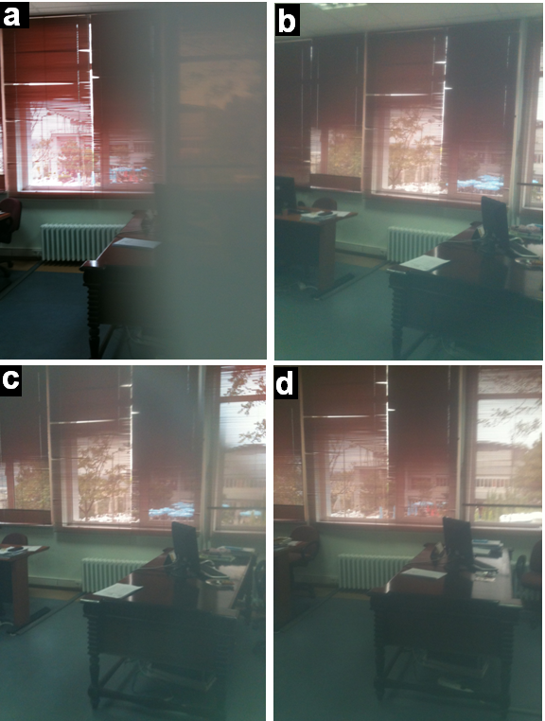
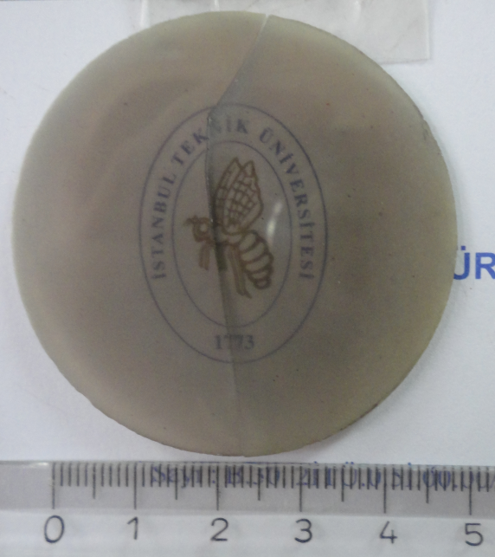
Production of Transparent Al₂O₃ Ceramics Using SPS
The images were obtained by placing the Al₂O₃ samples in front of the lens; a) The sample was sintered from Inframat Advanced Materials powders with high density, b) Undoped sample was sintered from TM-DAR powders, c) 150 ppm of MgO doped sample which was sintered from TM-DAR powders, d) The sample was annealed at 900 °C for 50 hours.
150 ppm of MgO and 150 ppm of Y₂O₃ doped sample which was sintered with a heating rate of 8 °C / minute and for 20 minutes at 1175 °C.

Slide 16
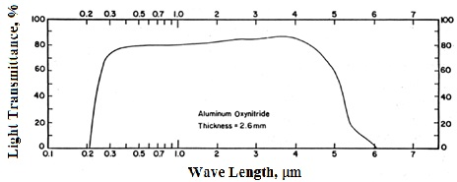
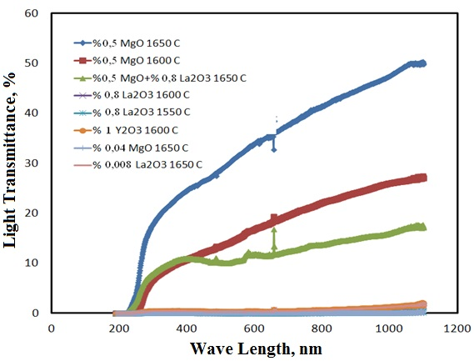
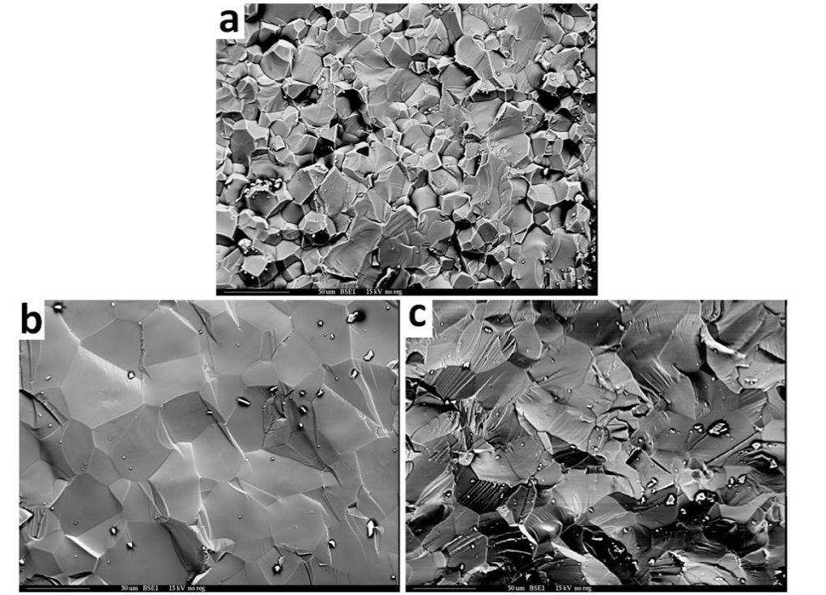
Effects of Additives on the Light Transmittance of AlON (Aluminum Oxynitride) Ceramics Sintered by using SPS
Linear light transmittance values of AlON for UV, visible and IR wave lengths.
Used Additives;
MgO, La₂O₃, Y₂O₃,
MgO + La₂O₃
Undoped
MgO added
c. La₂O₃ added
0.5% MgO added sample which was sintered by using Spark Plasma Sintering for 30 minutes at 1650 °C.

Slide 17
Explosive Consolidation
Explosive consolidation involves the use of detonation-induced shock waves traveling through an encased powder (or mixture of powders) to bring about their densification into a monolithic solid piece.
Explosive consolidation of powder has unique advantages over static compaction and subsequent heat treatment. They include;
Possibility of achieving densities approaching theoretical levels without the need for subsequent heat treatment,
Elevated temperature compaction for grain size tailoring or synthesis of a compound or alloy from the elemental components,
Removal of stoichiometry limitations leading to the formation of unique alloy compositions with special properties,
Possibility of tailoring detonation induced pressure and temperature to introduce or to totally obviate reaction within the constituent powders.
17

Slide 18
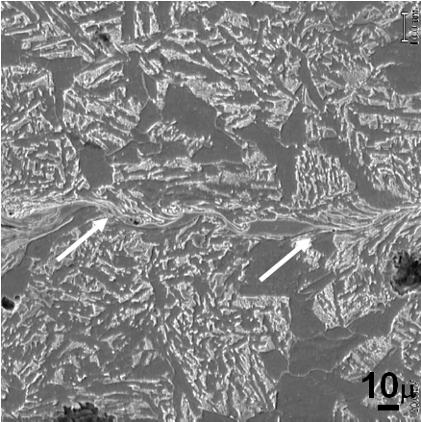
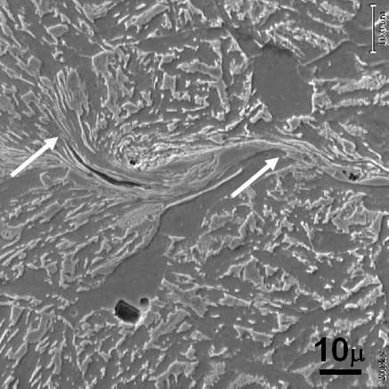
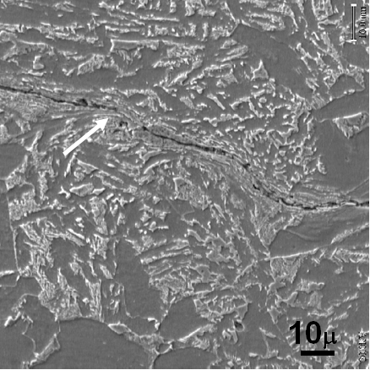
Mechanical Bonding by Explosive Consolidation
(Previous Studies)
SEM micrographs from a cross section of consolidated sample (8620 steel) revealing the interface in etched condition. Note that the deep appearance of the interface line is due to the effect of etching.
18

Slide 19
Diffusion Bonding Following Explosive Consolidation
(Previous Studies)
Mechanical bonding after explosive consolidation can be changed into diffusion bonding via a heat treatment. The purpose of this trial was to incorporate artificial defects into a metallic body. Artificil defects can be placed into a premachined surface before explosive consolidation process. After explosive consolidation diffusion bonding can be performed.
Such a metalic block could then be used as a calibration reference for ultrasonic inspection.
Diffusion bonding involves holding pre-machined components under load at an elevated temperature usually in a protective atmosphere or vacuum.
The loads are usually below those which would cause macro deformation of the parent materials and temperatures of 0.5-0.8Tm (Tm = melting point, K) are employed.
Times at temperature can range from 1 to 60+ minutes, depending upon the materials being bonded, the joint properties required and the remaining bonding parameters. Although the majority of bonding operations are performed in vacuum or an inert gas atmosphere, certain bonds can be produced in air.
19

Slide 20
Diffusion Bonding Following Explosive Consolidation
(Previous Studies)
Solid-state Diffusion
Stainless Steel 304
WC sphere
Bonding interface
Bonding via grain growth across interface
20

Slide 21
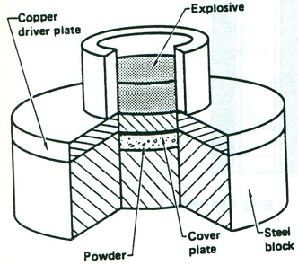
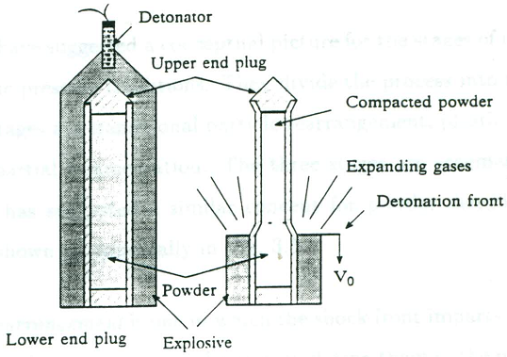
Explosive Consolidation of Aluminum – (SiC, B₄C) Composites
Shock Compaction Configuration in Plane Geometry
Shock Compaction Configuration in Cylindrical Geometry
Contents and approximate grain sizes of raw materials which were used in the experiments.
Component | Content, wt.% | Approximate Grain Size, μm
B₄C SiC Al Al 7075 Al 7093 | 98% B₄C, 2% C 99% SiC 99.8% Al 5.5% Zn, 2.5% Mg, 1.5% Cu 7% Zn, 2% Mg, 2% Cu, 0.14% Zr | ≤50 Particle: 20-50, Whisker: 3-20 ≤50 ≤50 ≤50
21

Slide 22
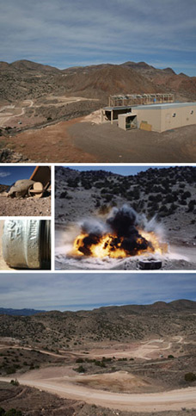
Doktora Sonrası Çalışmalar:
New Mexico Institute of Mining and Technology
Energetic Materials Research and Testing Center (EMRTC)

Slide 23
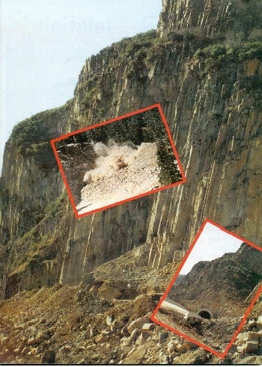
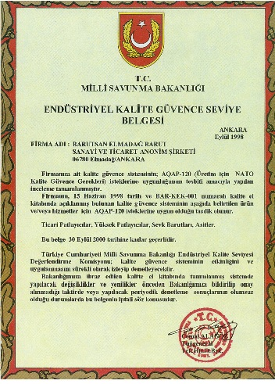
23

Slide 24
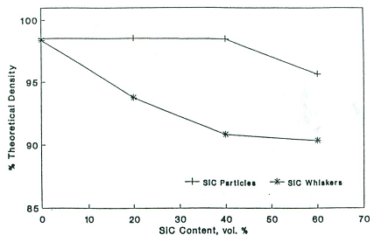
Explosive Consolidation of 7093 Aluminum - SiC Composites
Aluminum alloy (7093 ALCOA) – SiC (particulate or whisker) composites were consolidated with application of 10 – 12 Gpa pressure, induced by explosive detonation. The compacts produced exhibit high hardness (increasing with increased reinforcement), integrity and high density. Fracture toughness is seen to decrease with increased reinforcement. There is a strong indication that extensive shock hardening of the alloy matrix has taken place during consolidation. The study reaffirms explosive consolidation to be a unique mode for the production of these composites.
Properties of 7093 Al - SiC composites produced by explosive consolidation
Sample | Theoretical Density | Hardness | Fracture Toughness
Vol.% Reinforcement | % | Rockwell B | MPa∙m^{½}
Whisker
0 | 98.48 | 48 | 18.06
20 | 93.76 | 58 | 10.18
40 | 90.83 | 62 | 9.92
60 | 90.35 | 85 | 6.91
80 | 90.15 | >100 | -
Particle
0 | 98.54 | 48 | 18.38
20 | 98.53 | 64 | 13.30
40 | 98.48 | 77 | 11.60
60 | 95.65 | 88 | 7.55
80 | 89.59 | 69 | -
Percent theoretical density versus volume fraction of SiC reinforcement for 7093 aluminum-alloy-matrix composite (Each datum point corresponds to the average of 6 tests.)
24

Slide 25
Microhardness versus volume fraction of SiC reinforcement for 7093 aluminum-alloy-matrix composite (Each datum point corresponds to the average of 10 tests.)
Fracture toughness versus SiC reinforcement content for 7093 aluminum-alloy-matrix composite (Each datum point corresponds to the average of 6 tests.)
Microstructures and corresponding fracture surfaces for SiC-particle-reinforced 7093 aluminum alloy; (a-b) 0%, (c-d) 20%, (e-f) 40%, (g-h) 60% by volume of the reinforcement

Slide 26
Explosive Consolidation of Aluminum - B₄C Composites
The technique of explosive consolidation was used to prepare cermets of boron carbide with aluminum and 7075 aluminum alloy. Compacts were produced by application of 10-12 Gpa pressure which was induced by explosive detonation. The compacts obtained exhibit high hardness-increasing with an increase in the boron-carbide content, integrity and close to theoretical density. Hardness, fracture toughness and flexural strengths of the composites produced indicate extensive shock hardening of the metal (or alloy) matrix during consolidation.
Experimental data on the fabrication of aluminum-boron carbide compacts by explosive consolidation
26

Slide 27
Hardness as a function of boron carbide content in consolidated composites
Hardness as a function of density of compacts
The relation between hardness and flexure strength
of compacts
The relation between hardness and fracture toughness
of compacts
27

Slide 28
Conclusions
The various types of refractory ceramic compounds have been produced by using both carbothermic and SHS processes in our laboratories such as B₄C, TiB₂, ZrB₂, W_{x}B_{y} etc.. Explosive consolidation has been also studied for the production of particularly Al-(B₄C, SiC) composites as a cheaper and superior-results-providing method in comparison to conventional compacting techniques (HP, SPS).
Explosive consolidation can be used to produce metal/ceramic composites that exhibit integrity, high density, and no reactivity between the constituent powders. Since the process has a duration of 2 μsec, and requires no expensive tooling, it is an attractive route for MMC production.
Higher ceramic content is seen to lead to higher hardness, lower percent theoretical density, and lower fracture toughness.
For Al-SiC composites, the hardness and fracture toughness of the particulate-reinforced composites are superior to those of the whisker-reinforced composites.
SEM of fracture surfaces, as well as optical metallography, indicate good attachment between the ceramic and the alloy matrix, with uniform distribution of the ceramic and the absence of microcracking.
THANK YOU

Slide 29
XIII International Symposium on Self-Propagating High Temperature Synthesis
Previous SHS Symposia
Kazakhstan (1991)
USA (1993)
China (1995)
Spain (1997)
Russia (1999)
Israel(2002)
Poland (2003)
Italy (2005)
France (2007)
Armenia (2009)
Greece (2011)
USA (2013)
Turkey (2015)
SHS 2015
Antalya/Turkey

